Slide 1
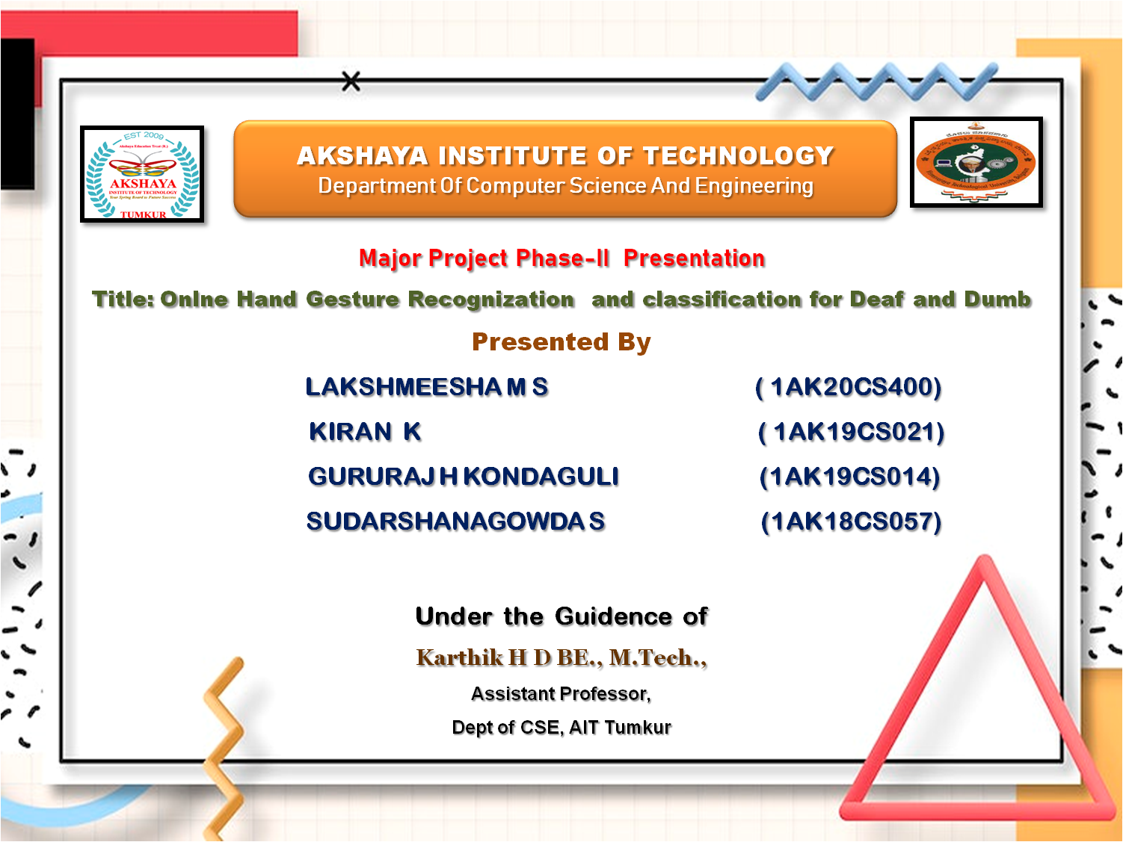

Slide 2

PRESENTATION OUTLINE
Introduction
Problem Statement
Solution to the Problem
Literature Survey
Inferences from Literature Survey
Objectives
Hardware and Software Requirements
System Design
Existing System
Proposed System
Advantages and Disadvantages
Conclusion
References

Slide 3
INTRODUCTION
Sign Language Recognition is a breakthrough for helping deaf-mute people and has been researched for many years.
Unfortunately, every research has its own limitations and are still unable to be used commercially.
Nowadays, researchers have gotten more attention for developing Sign Language Recognition that can be used commercially.
Researchers do their researches in various ways. It starts from the data acquisition methods. The data acquisition method varies because of the cost
Each method has its own strength compare to other methods and researchers are still using different methods in developing their own Sign Language Recognition.
The aim of this project is to review the sign language recognition approaches and find the best method that has been used by researchers.

Slide 4

PROBLEM STATEMENT
Some of the problems faced by non-speech and hard-of-hearing individuals in communication with other people were interaction-based, disparity, education, behavioural patterns, mental health, and most importantly safety concerns.
Physical action carried by the hand, eye or any part of the body can be considered a gesture.
single-handed recognition system is proposed, it uses right-handed gestures, and is classified recognized the specific character.

Slide 5

SOLUTION TO THE PROBLEM
As part of this research, we developed a technology that recognizes the sign language and give the appropriate output in a sentence or alphabet form.
This technology improves communicational skills for the deaf and dumb peoples.
The CNN module is designed for proper sign recognization within a limited time.

Slide 6
LITERATURE REVIEW
AUTHOR | YEAR OF PUBLICATION | DESCRIPTIONS | PROS | CONS
Soma Shrenika | 2020 | Sign Language Recognition Using Template Matching Technique | Edges are then determined using an edge detection algorithm | Preprocessing not explained
H Muthu Mariappan | 2019 | Real-Time Recognition of Indian Sign Language | Real-time signs are interpreted with greater accuracy | Can’t handle multiple request at a time
Wanbo Li | 2021 | Sign Language Recognition Based on Computer Vision | OpenCv evaluates the precision to the best mark | Conversion take more time

Slide 7
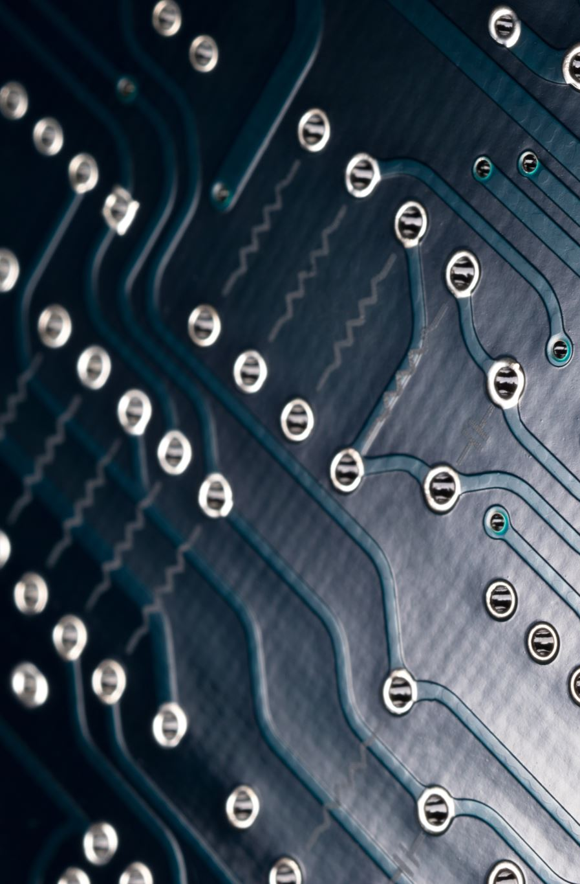
DESCRIPTION OF SOFTWARE FOR IMPLEMENTATION
Hardware specifications:
Processor : Pentium Dual Core 2.00GHZ
Hard disk : 120 GB
RAM : 2GB (minimum)
Keyboard : 110 keys enhanced
Software specifications:
Operating system : Windows7 (with service pack 1), 8, 8.1 and 10
Language : Python

Slide 8
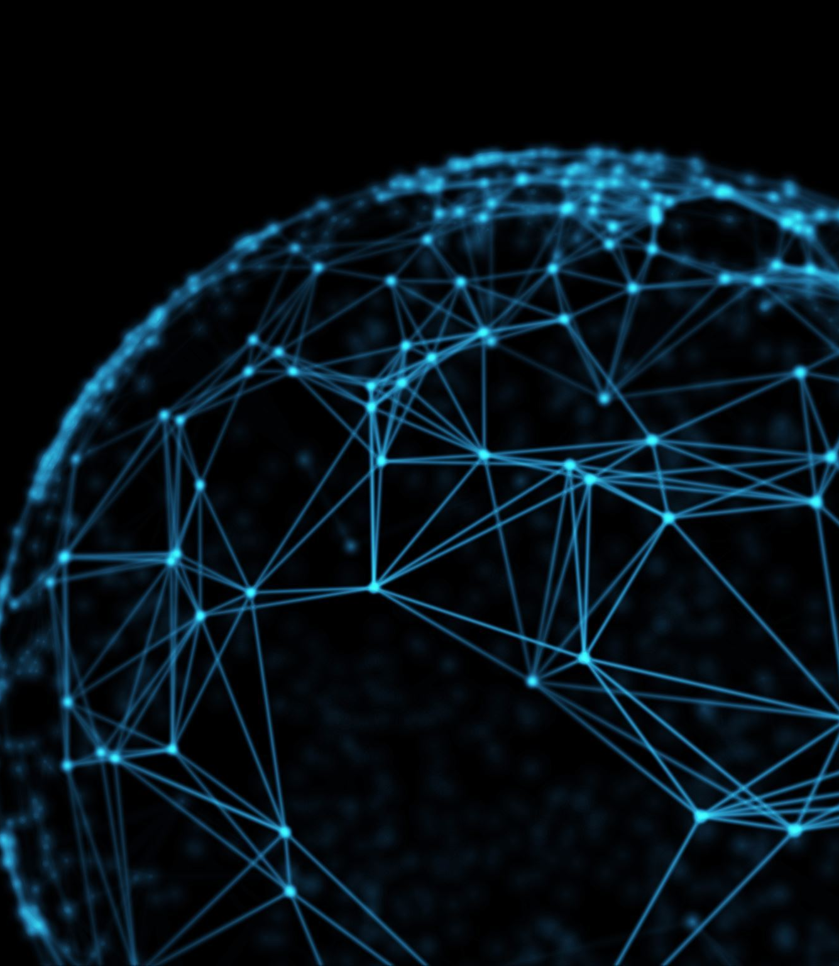
EXISTING SYSTEM
Virtual reality, sign language recognition, and HCI are just a few of the many areas that may benefit from advancements in the field of computer vision known as hand gesture recognition.
For hand gesture recognition, artificial neural networks are one of the most used methods (ANNs).
The existing systems have low accuracy and operate at a reduced speed as compared to other systems.
The existing systems also have low precision and potentially high error value.

Slide 9
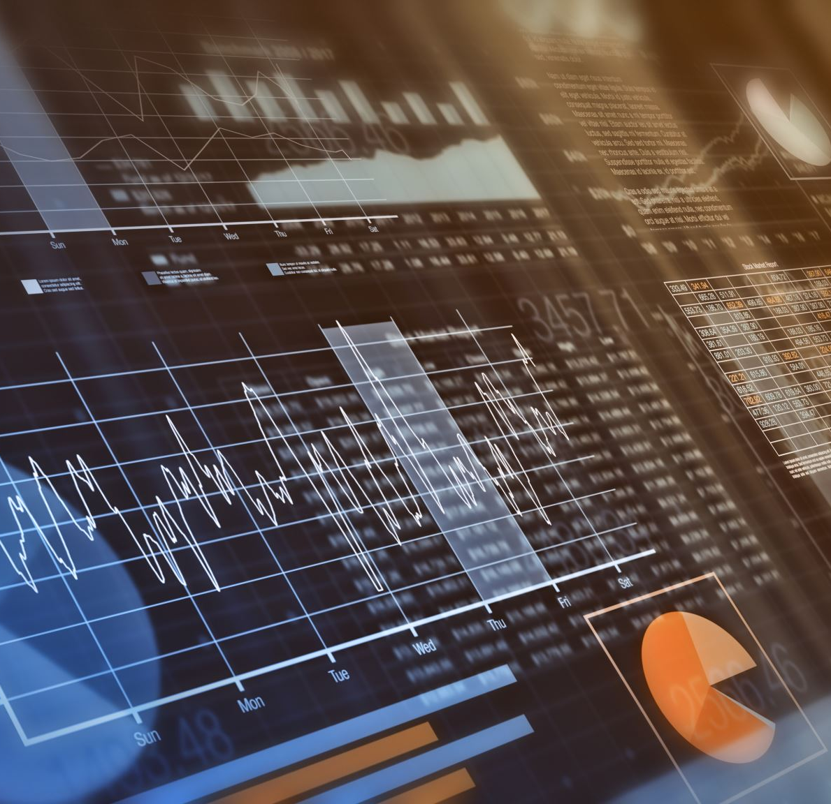
PROPOSED SYSTEM
The proposed system for recognizing handwritten digits with the help of a classifier is particularly important for the following applications such as online digit recognition on a tablet computer, recognize zip codes on mail, processing bank check applications.
. The proposed CNN performance is evaluated through the hyperparameters like training and validation loss measures that determine the proposed model’s capabilities.
The Advantages of the proposed system are Secured, Interpretability, High accuracy, Lightweight model & fast processing.
The proposed system leverages a practical approach that gives better results with high accuracy.

Slide 10

OBJECTIVES
The main objective of the project of this project is to develop a computer-based intelligent system that will enable dumb people significantly to communicate with all other people using their natural hand gestures.
The main objective of the project is recognize all 26 Alphabets with the aid of hand gestures through a web camera.

Slide 11
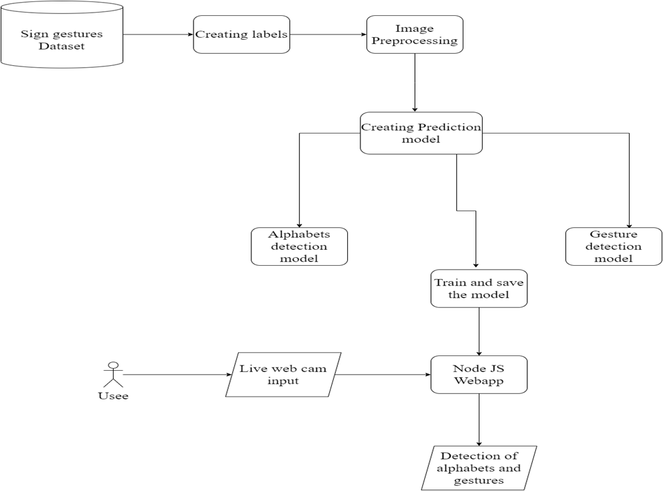
SYSTEM ARCHITECTURE

Slide 12

DESIGN AND METHODOLGY
In this paper, we developed a convolutional neural network to classify finger spell images using image intensity and depth data.
The developed convolution network is evaluated by applying it to finger gesture recognition.
The following are the methodologies used for designing the System.
GUI(Grapical User Interface
Data Pre-Processing
Building CNN Module.

Slide 13
GUI
In this project, the input is in the form of images.
The dataset was gathered by capturing continuous images using Python.
Then, these images were automatically cropped and converted to a 50 ×50 pixels black and white sample.
The altered sample input with the data is required to predict the signs.
Python offers multiple options for developing GUI (Graphical User Interface). Out of all the GUI methods, Tkinter is the most commonly used method
Tkinter is lightweight and relatively painless to use compared to other frameworks. This makes it a compelling choice for building GUI applications in Python

Slide 14
DATA PRE-PROCESSING
Data pre-processing comes under data mining and analysis. It deals with raw data and transforms it into a usable format that computers can readily put to use.
The data is cleaned and pre-processed at this stage, where missing and null value records are dropped.
In our dataset, we cleaned all the null values and checked whether all the data types are valid. Missing values are also dealt with.
Data cleaning also caters to noisy data (meaningless data). Such values cannot be interpreted by the system.

Slide 15
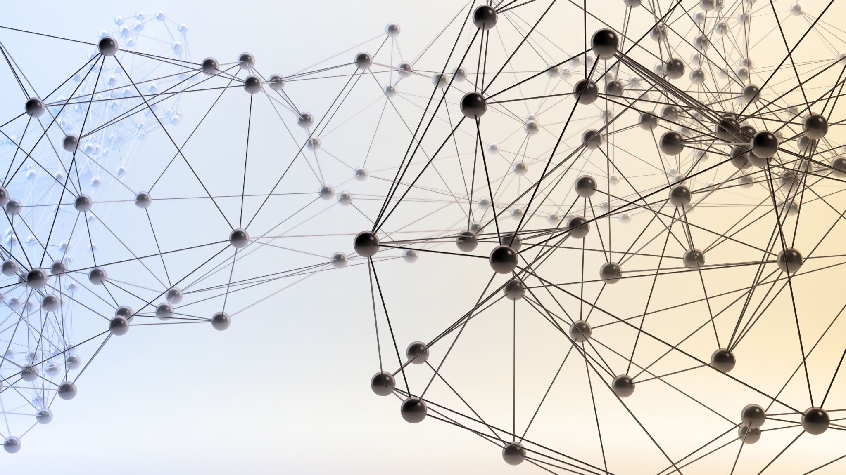
BUILDING CNN MODULE
Here comes the part where the classifying model is actually built. CNN or convolutional neural networks has become a renowned algorithm of deep learning.
Most CNN models require images as the inputs and then recognize/classify/predict their features.
Convolutional Neural Network processes these images and identifies them on the basis of certain features.
The reason for this circumstance is that it is used mostly in every field like in this project, for hand gesture recognition.

Slide 16
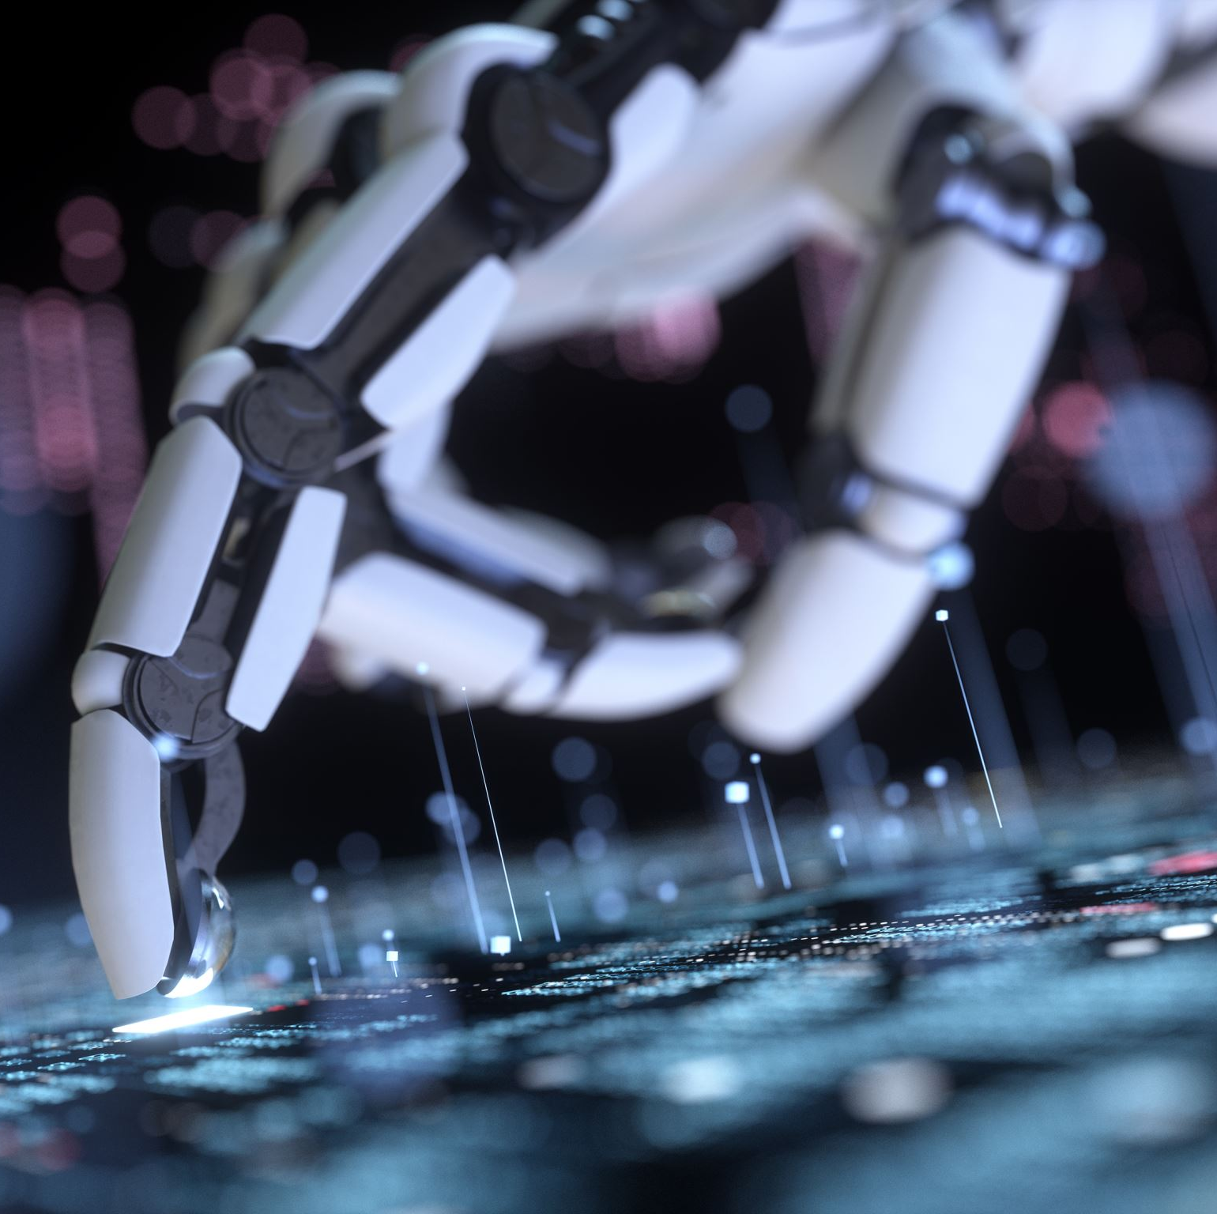
ADVANTAGES
Speed and sufficient reliable for recognition .
system.Good performance system with complex background.
The system successfully recognized static and dynamic gestures.
Simple ,fast, and easy to implement.Can be applied on real system and play games.
Accessibility
Convenience
Language learning
portable
.Helps people with disabilities

Slide 17
DISADVANTAGES
Irrelavent object might overlap with the hand.
Performance recognition algorithm decreases when than 1.5 meters between the user and the camera.
System limitations restrict theapplications such as the arm must be vertical, the palm is facing in the camera and the finger.

Slide 18
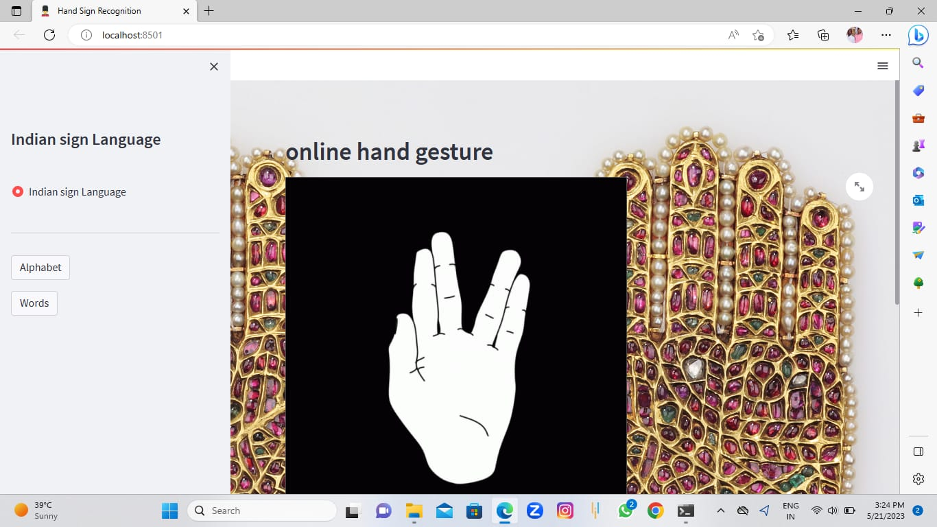
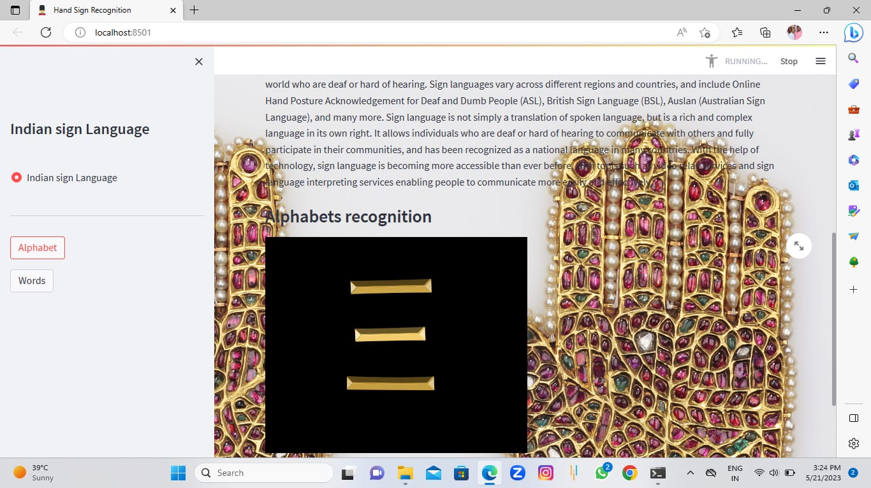
SNAPSHOTS

Slide 19
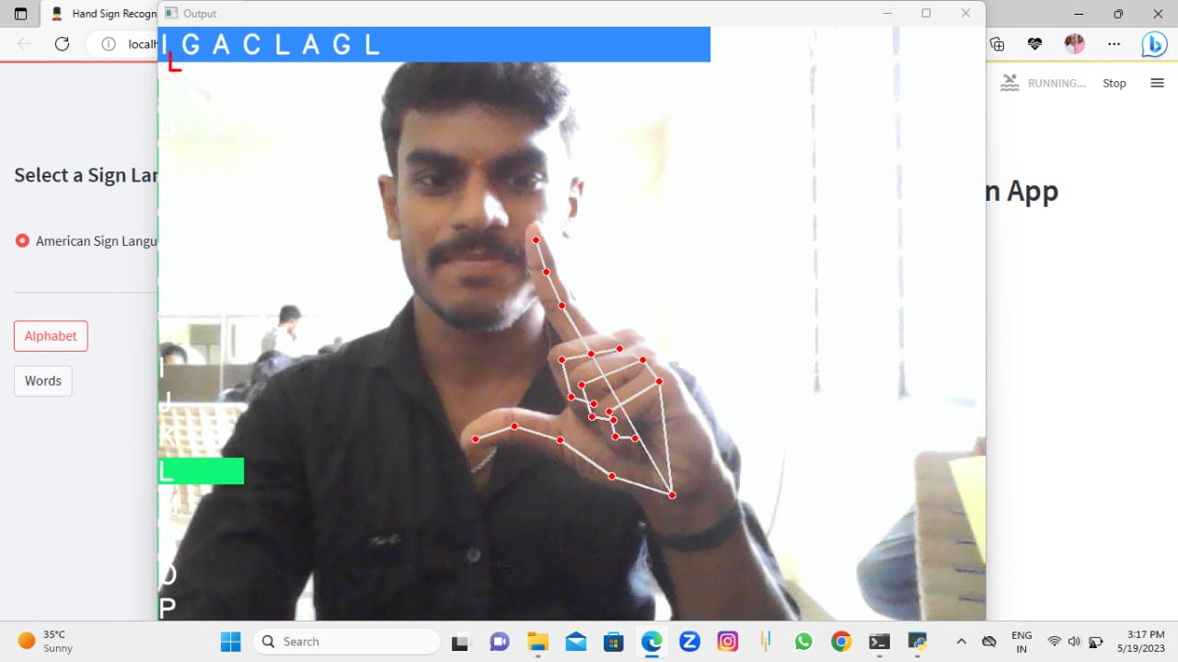
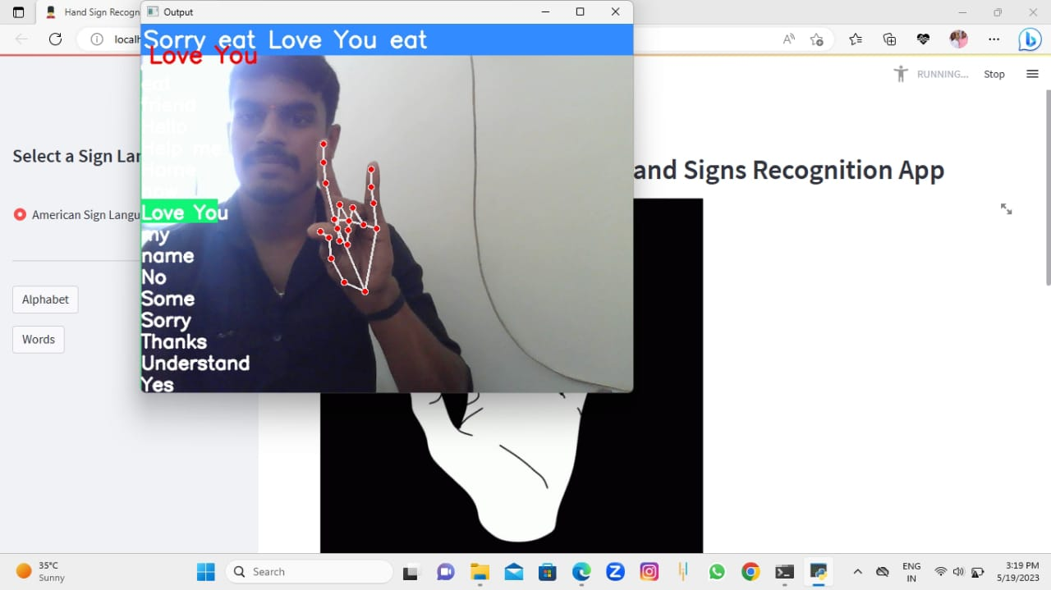

Slide 20

CONCLUSION
Our proposed system was able to achieve 99% training accuracy, with testing accuracy of 90.04% in letter recognition, 93.44% in number recognition, and 97.52% in static word recognition, obtaining an average of 93.667% based on the gesture recognition with limited time.
.Each system was trained using 50 × 50 images of each letter/number/word gesture.
This approach yields better accuracy and considerably low false positives.
Time frame selection techniques can be bettered, more optimization can be added, and the loss function can be studied more deeply.

Slide 21
REFERENCES
Divya Deora and Nikesh Bajaj, "Indian Sign Language Recognition", in Emerging Technology Trends in Electronics, Communication and Networking (ET2ECN), 2012 1st International Conf. , 2012. doi: 10.1109/ET2ECN.2012.6470093
Y. Lee, Y. Goh, Lum Kin Yun, “Study of Convolutional Neural Network in Recognizing Static American Sign Language”, 2019 IEEE International Conference on Signal and Image Processing Applications (ICSIPA), 2019
S. Preetha Lakshmi, S. Aparna, V. Gokila & Prithviraj Rajalakshmi, “Hand Gesture Recognition Using CNN”, Part of the Smart Innovation, Systems and Technologies book series (SIST,volume 243), Springer, 2021
Aparna Mohanty, Sai Saketh Rambhatla & Rajiv Ranjan Sahay, “Deep Gesture: Static Hand Gesture Recognition Using CNN”, Part of the Advances in Intelligent Systems and Computing book series (AISC,volume 460), Springer, 2016
Xiao Yan Wu, “A hand gesture recognition algorithm based on DC-CNN”, Multimedia Tools and Applications volume 79, pages9193–9205 (2020) , Springer, 2019.

Slide 22
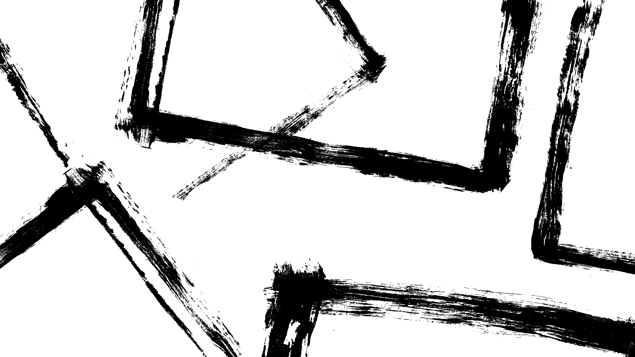

THANK YOU

